Slide 1
HTML Frames

Slide 2
Frames
HTML frames are used to divide your browser window into multiple sections where each section can load a separate HTML document.
A collection of frames in the browser window is known as a frameset.

Slide 3
The <frameset> Tag
<frameset> requires a closing </frameset> tag
Determines the frame types and sizes on the page
Two frame types:
  Columns
  Rows

Slide 4
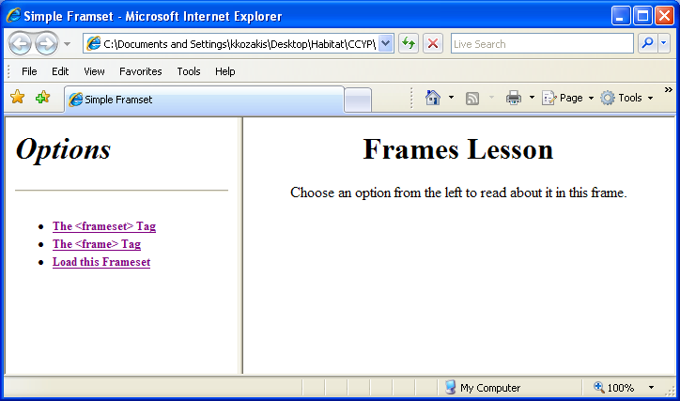
Columns Example
This frameset was created by the following code:
<frameset cols="35%,65%"> </frameset>
Absolute values in pixels. For example to create three vertical frames, use cols="100, 500,100".

Slide 5
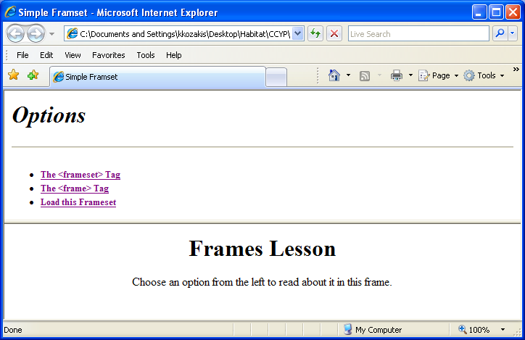
Rows Example
This frameset was created by the following code:
<frameset rows=“65%,*"> </frameset>

Slide 6
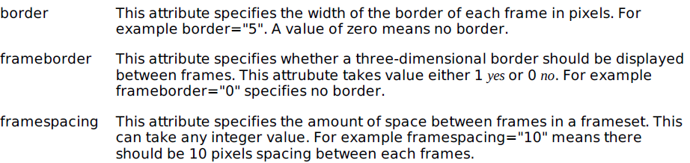
<frameset attributes>
rows
cols
border
frameborder
framespacing

Slide 7
The <frame> Tag
Defines the content in each frame
Placed between the <frameset> </frameset> tags
The src attribute specifies the file that appears in the frame
In the following example, the page that will appear in the top frame is the file fl-toc.html, and the page that will appear in the lower frame is fl-second.html.
<frameset rows=“70%,*">
<frame src="fl-toc.html"/>
<frame src="fl-second.html"/>
</frameset>

Slide 8
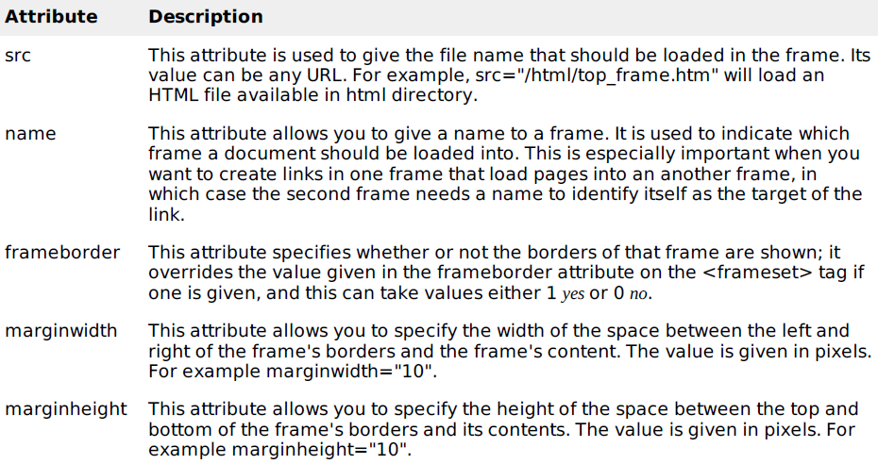

<frame> Attributes

Slide 9
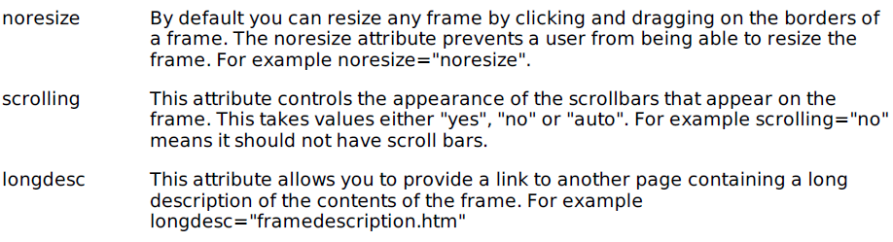
<frame> Attributes

Slide 10
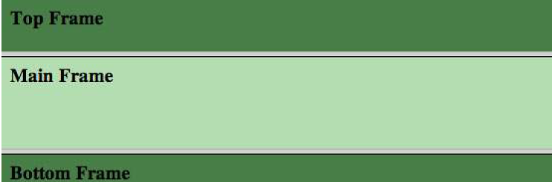

Slide 11
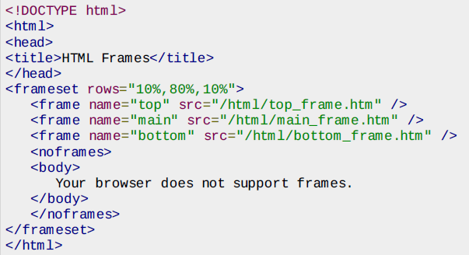

Slide 12
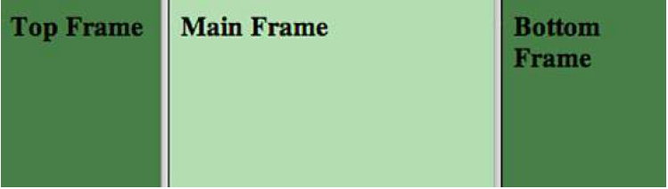

Slide 13
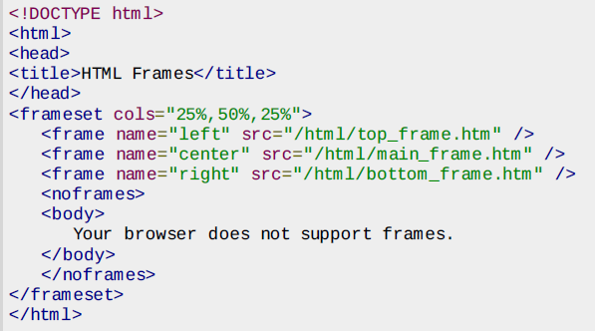

Slide 14
The <noframes> Tag
If a user is using any old browser or any browser which does not support frames then <noframes> element should be displayed to the user.
So you must place a <body> element inside the <noframes> element because the <frameset> element is supposed to replace the <body> element, but if a browser does not understand<frameset> element then it should understand what is inside the <body> element which is contained in a <noframes> element.

Slide 15
Targeting Frames with Hyperlinks
Use the name attribute to name a frame, then target the frame name with hyperlinks
The syntax for naming a frame is as follows:
<frame src="url" name="framename"/>
The following code names a frame:
<frame src="james.html" name="authors"/>
The following code targets this frame:
<a href="james.html" target= "authors"> Visit James </a>
If a user clicks the Visit James link, the James page will open in the Authors frame

Slide 16
Base Target
A base target automatically sets a default target frame for all links in a page
Created using the <base> tag
Code:
<base target="main" href="page.html"/>
This code will cause all linked pages to open in the frame named Main
The href attribute is optional

Slide 17
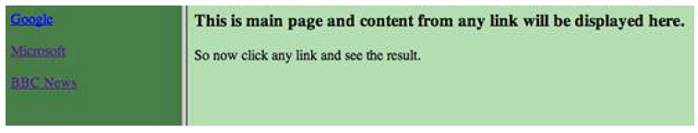
Example Page

Slide 18
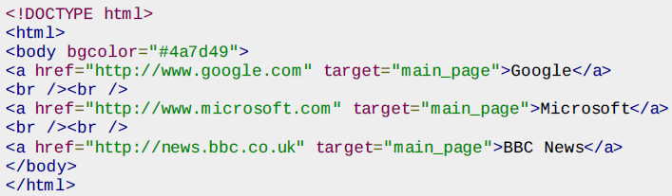
menu.htm

Slide 19
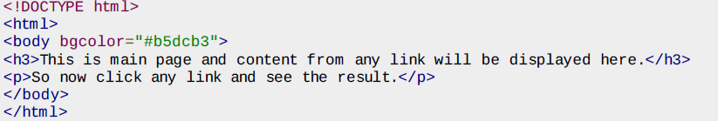
Content.html

Slide 20
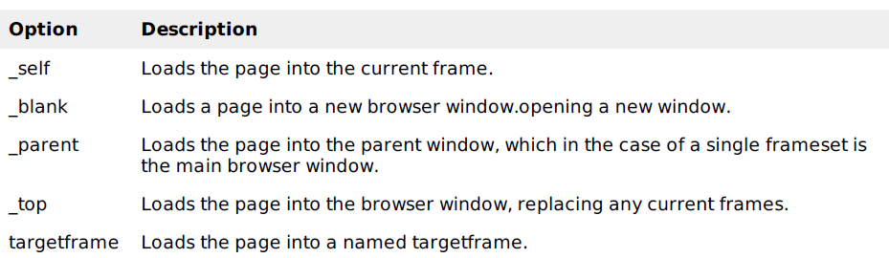

Slide 21
Inline Frames
Inserts an HTML or XHTML document inside another
Also called "floating frames"
Created with the <iframe> tag
The browser reads the <iframe> tag from the file, then makes a separate request to the server for the embedded file

Slide 22
Inline Frames (cont’d)
Simple XHTML page with inline frame:
<h1>iFrame Example</h1>
<p><strong>This text is found in iframe.html</strong><p/>
<iframe src="embedded.html" scrolling= "yes">
Your browser does not support frames.
</iframe>
<p><strong>This text is also found in iframe.html. </strong></p>
The next slide shows the results of this code…

Slide 23
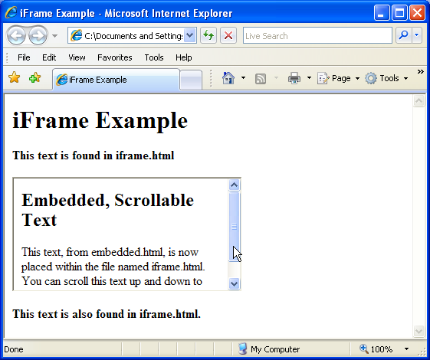
Inline Frames (cont’d)

